Slide 1
Automating the Analysis Process automodel

Slide 2
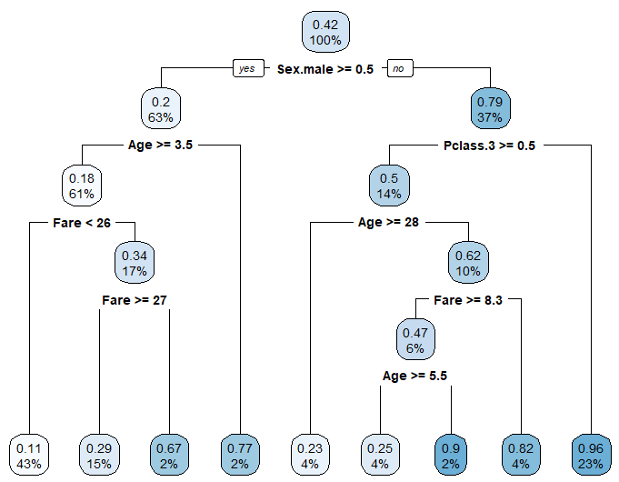

What is
automodel?
Example CART model generated by automodel
Useful for:
rough initial models
Finds significant variables
Determining relationships
WARNING
Not be used as final result!

Slide 3

1st data-set: Titanic
https://www.kaggle.com/c/titanic

Slide 4


2nd data-set: House Prices
https://www.kaggle.com/competitions/house-prices-advanced-regression-techniques

Slide 5
Enough Here, Time for Example!

Slide 6
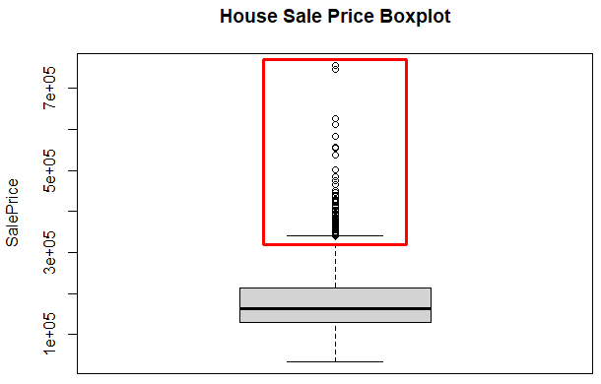

Improvements
Outliers in SalePrice
NOT ACCOUNTED FOR!!!
Areas to improve:
Outlier handling
Better coding structure (modular)
More within section 7.3 Future Improvements
Length of automodel.r
Hard to interpret!

Slide 7
Thanks For Listening! Any Questions?

